Slide 1
Sonic Choking

Slide 2
Overview
What is sonic choking and where does it occur?
How does Arrow take sonic choking into account?
How are models with multiple choke points handled?

Slide 3
Sonic Choking Overview
A phenomenon that occurs in gas piping systems where the local gas velocity reaches sonic speed
Gas velocity limited to sonic speed in Arrow
Arrow does not model supersonic flow
When flow is choked, decreasing the downstream pressure will not increase flow

Slide 4
Choking and Fanno Line
The Fanno line shows the thermodynamic process in adiabatic pipe flow in terms of entropy and enthalpy
Entropy must increase, so gas accelerates along the pipe towards sonic point
Fanno line shape determined by continuity equation, energy equation, momentum equation, and equation of state
h
$$h_{0}=h+\frac{1}{2}V^{2}$$
$$\frac{1}{2}V^{2}$$
M < 1 (subsonic)
Stagnation enthalpy is constant
Sonic Point
M > 1 (supersonic)
Trivia!
s_{max}
s

Slide 5
Types of Choking 1
Restriction Choking: Flow chokes at restriction
Three types of choking:
Restriction choking
Expansion choking
Endpoint choking
Mach number of 1 at restriction not graphed for clarity

Slide 6
Types of Choking 2
Expansion Choking: Flow chokes at expansion
Endpoint Choking: Flow chokes at endpoint

Slide 7
Determining Choked Flow
To check for choking, calculate theoretical choked flowrate based on effective flow area (A)
For expansion and endpoint choking, A = upstream pipe area
For restriction choking, A = CdA for sonic choking
Restriction choking cannot be calculated without CdA for sonic choking
If flow in model reaches choked flowrate, solver transitions to sonic calculations
Equations use conditions upstream of chokepoint
Mach number is 1 for choked flow
$$\dot{m}=A\frac{P_{0}}{\sqrt{T_{0}}}f{(M)}_{M=1}$$
$$f(M)=\sqrt{\frac{γ}{ZR}}M{\left(1+\frac{γ−1}{2}M^{2}\right)}^{{−\left(γ+1\right)}/{\left[2\left(γ−1\right)\right]}}$$
Notes:
Sonic choking depends on the local velocity, which depends on the local flow area

Slide 8
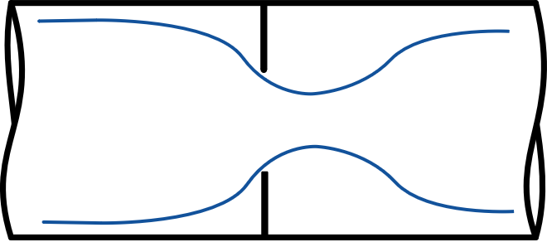
Sonic Area
The flow area that would cause choking for a certain flow can be calculated
Useful to predict if choking is present when CdA for sonic choking is unknown
If $Asonic$ > ${(C_{d}A)}_{est}$, the flow will be choked
Flow Choked $Asonic > {\left(C_{d}A\right)}_{est}$
$$\dot{m}=A\frac{P_{0}}{\sqrt{T_{0}}}f{(M)}_{M=1}$$
$$A_{sonic}$$
$${(C_{d}A)}_{est}$$
$$A_{sonic}=\dot{m}\frac{\sqrt{T_{0}}}{P_{0}f{(M)}_{M=1}}$$
Flow Not Choked
$$Asonic< {\left(C_{d}A\right)}_{est}$$
$$A_{sonic}$$
Arrow will compare $Asonic$ to the area of the restriction to warn if choking might occur at junctions when no CdA is entered
$${(C_{d}A)}_{est}$$

Slide 9
Calculations at Choking Point
If choking is detected, solution must be re-evaluated
Pressure and flow results with subsonic equations are not valid
Choked mass flowrate can’t be directly calculated
Pressure and temperature at the choke point are unknown
Density at the choke point is unknown
We must guess flow and iterate for a solution
This calculation will be similar for all 3 types of choking
$$\dot{m}=A\frac{P_{0}}{\sqrt{T_{0}}}f{(M)}_{M=1}$$
?
$$\dot{m}=ρAV$$

Slide 10
Calculations Downstream of Choke Point
Downstream of a choke point we know:
Mass flow rate
Stagnation enthalpy
Must iterate for all other parameters based on downstream boundary
Pressure
Temperature
Density
Velocity
?
Notes:
Pressure drop from restriction or expansion will be determined by downstream boundary condition

Slide 11
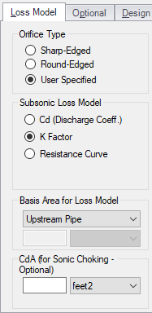
Sonic Pressure Loss
Different loss models used for junctions that choke
CdA for Sonic Choking
Unrelated to subsonic loss model
CdA must be determined by testing
Loss calculated based on downstream conditions
Valve Cv/Xt
Applicable for both subsonic and sonic loss
Notes:
Note: Valve Cv/Xt discussed previously in chapter 16

Slide 12
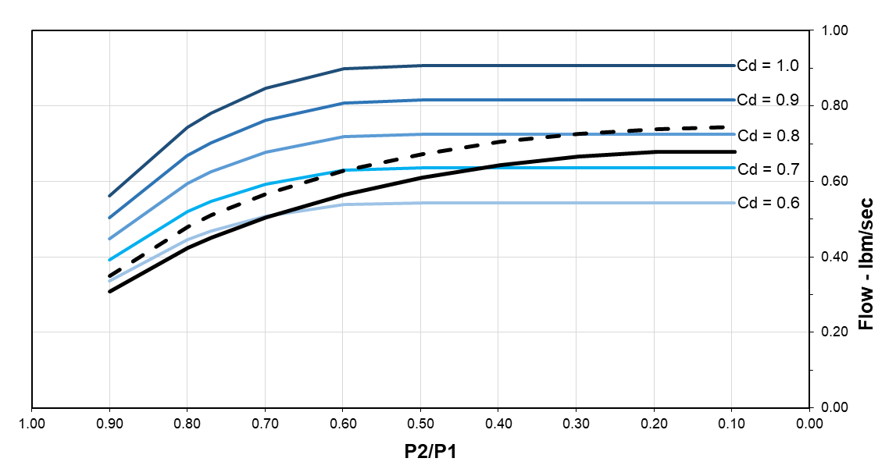
CdA for Sonic Choking
The value of Cd varies over different pressure ratios
CdA is not equivalent to the subsonic discharge coefficient times the area
Models based on empirical data show that Cd increases as the pressure ratio decreases
Notes:
Figure comes from “Modeling Choked Flow Through an Orifice” white paper, shows that Cd is variable and depends on the operating conditions

Slide 13
Flowrate When Changing Conditions
When changing downstream pressure
Flow increases nonlinearly when subsonic
Flow is limited to sonic flow rate
When changing upstream pressure
Choked flow rate increases linearly
$$\dot{m}∝\sqrt{dP_{o}}$$
$${\dot{m}}_{choked}∝P_{o,supply}$$

Slide 14
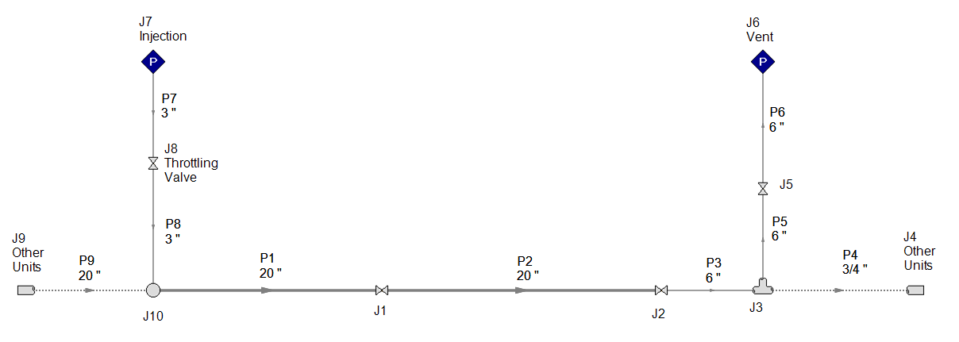
Example - Air Blowdown
Open “Air Blowdown – Given”
An engineer is analyzing the injection and vent lines for an air blowdown process to remove particulates from this system
Blowdown process has a minimum pressure requirement of 30 psia (2 bar) in the 20-inch lines (P1 & P2), and a maximum velocity limit of 600 ft/s (180 m/s) at the vent

Slide 15
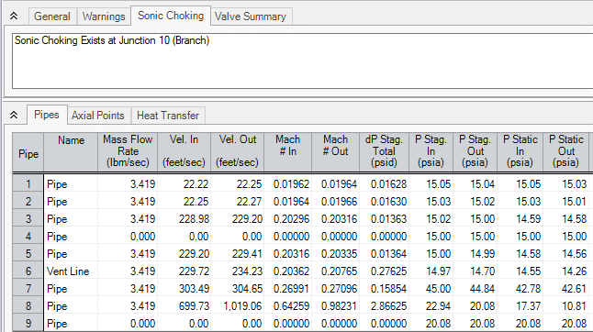
Example – Air Blowdown – Output
Sonic choking is occurring at the expansion from the injection line
The minimum pressure of 30 psia is not met in the system lines
Mach number of 1 at end of pipe (difference due to rounding error)
Notes:
Note that expansion choking can happen at branches/tees as well as at the Area Change junction, if the area is ultimately increasing

Slide 16
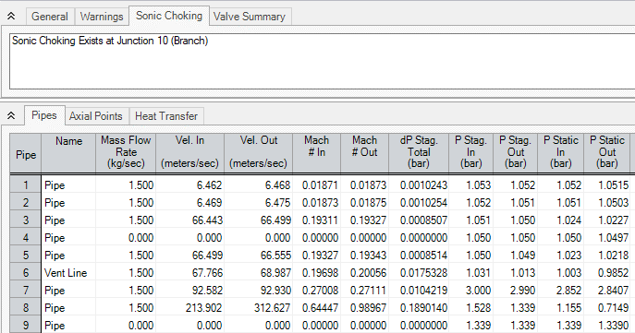
Example – Air Blowdown – Output
Sonic choking is occurring at the expansion from the injection line
The minimum pressure of 2 bar is not met in the system lines
Mach number of 1 at end of pipe (difference due to rounding error)
Notes:
Note that expansion choking can happen at branches/tees as well as at the Area Change junction, if the area is ultimately increasing

Slide 17
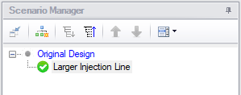
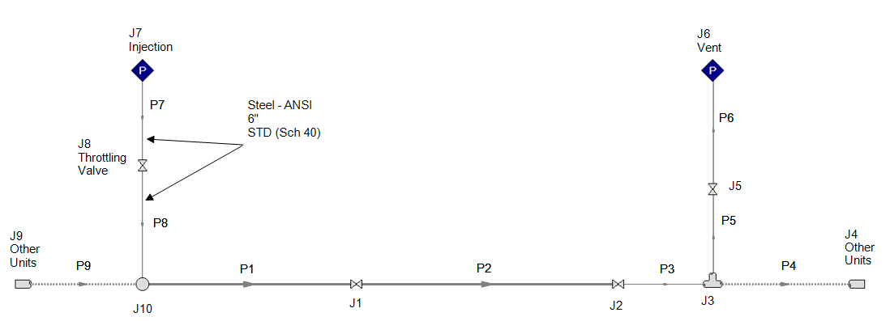
Example – Air Blowdown – Increase Line Size
Increase the injection line size to prevent choking at the expansion, therefore increasing pressure
Create a child scenario and name it “Larger Injection Line”

Slide 18
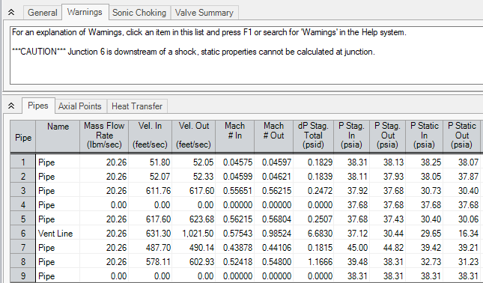
Example – Air Blowdown – Increase Line Size
Arrow cannot solve for velocity downstream of the endpoint, thus conversion between static and stagnation properties is impossible
Endpoint choking occurs at vent
Pressure exceeds 30 psia in system
Velocity at the vent now exceeds maximum velocity of 600 ft/s

Slide 19
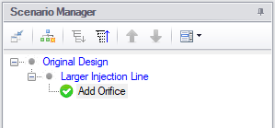
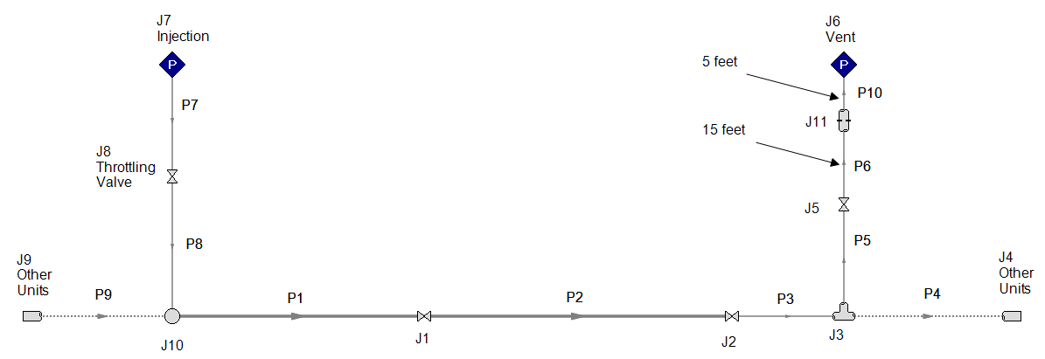
Example – Air Blowdown – Add Orifice
J11 - Orifice | Elevation: 0 ft Type: Sharp-edged Area: 0.1 ft² CdA for Sonic Choking: 0.05 ft²
Create a child scenario and name it “Add Orifice”

Slide 20
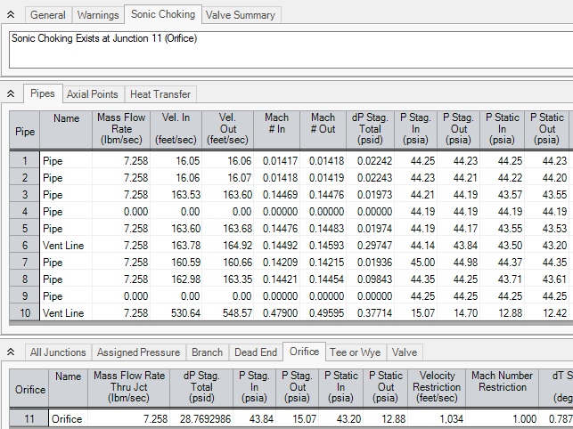
Example – Air Blowdown – Add Orifice
Restriction choking occurs at orifice
Velocity at vent is now below 600 ft/s
Properties such as velocity and Mach number at the restriction can be added to output

Slide 21
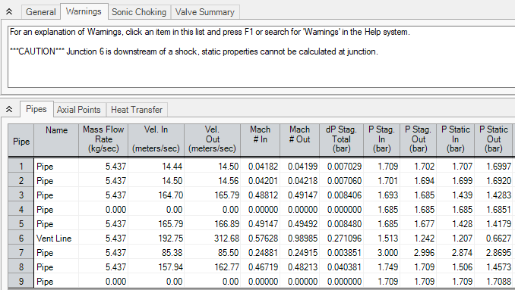
Example – Air Blowdown – Increase Line Size
Arrow cannot solve for velocity downstream of the endpoint, thus conversion between static and stagnation properties is impossible
Endpoint choking occurs at vent
Pressure exceeds 2 bar in system
Velocity at the vent now exceeds maximum velocity of 180 m/s

Slide 22
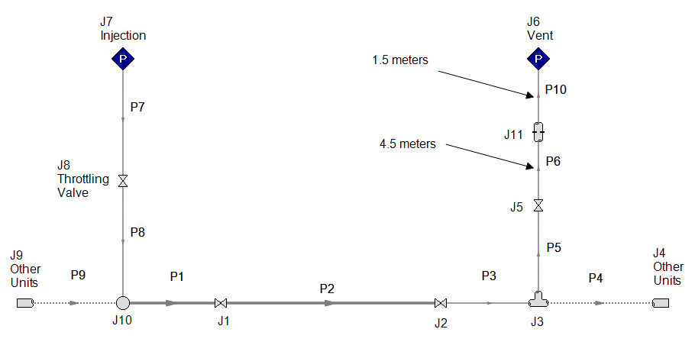
Example – Air Blowdown – Add Orifice
J11 - Orifice | Elevation: 0 m Type: Sharp-edged Area: 93 cm² CdA for Sonic Choking: 46.5 cm²
Create a child scenario and name it “Add Orifice”

Slide 23
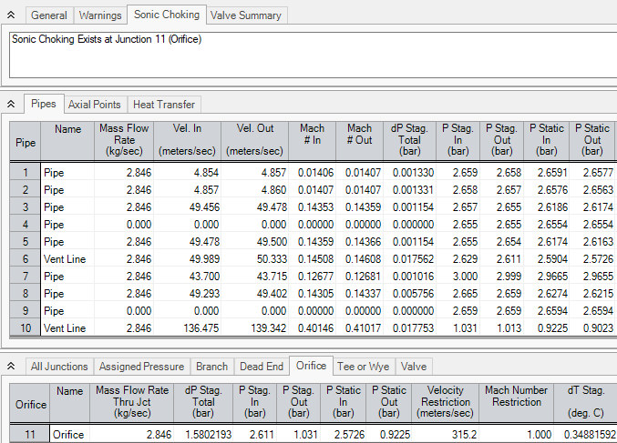
Example – Air Blowdown – Add Orifice
Restriction choking occurs at orifice
Velocity at vent is now below 180 m/s
Properties such as velocity and Mach number at the restriction can be added to output

Slide 24
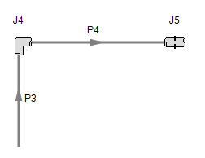
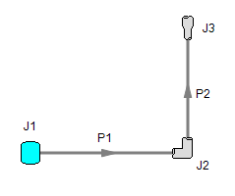
Multiple Sonic Choking Points 1
Once sonic choking is determined for a flow path, the rest of the flow path is solved as a pseudo-system
Known flow rate is imposed
on pseudo system after
the expansion
similar to a known
inflow boundary condition
Known flowrate is imposed on pseudo system after the orifice similar to a known inflow boundary condition
Sonic flowrate determined by system up to expansion

Slide 25
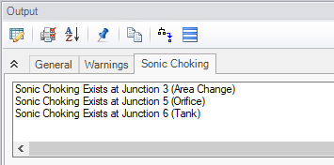
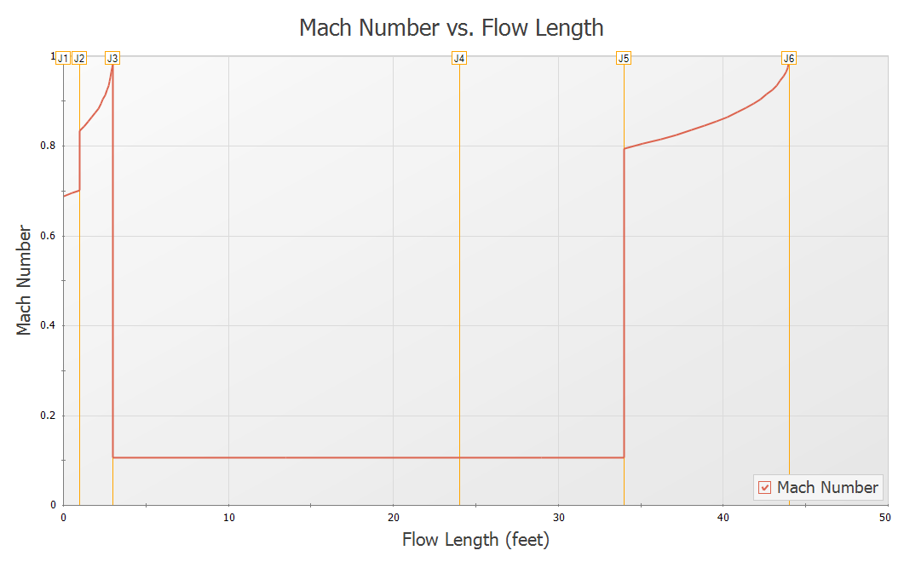
Multiple Sonic Choking Points 2
Choking at area change
Choking at endpoint
Choking at orifice not shown on graph since the restriction point is not explicitly shown on the pipe profile graph

Slide 26
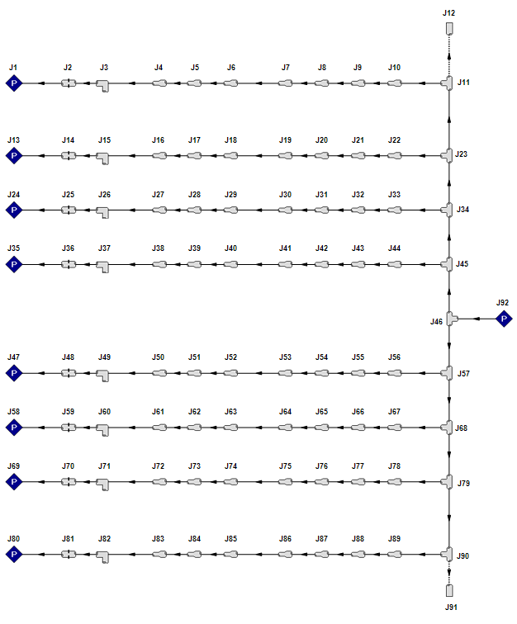
Fern Engineering
AFT Arrow Powers Gas Turbine Analysis at Fern
Benchmarked model
Large exhaust gas temperature variations existed in gas turbine fleet
Calibrated model of the existing system was required to evaluate possible solutions
Arrow’s sonic choking predictions benchmarked against data from a test rig
The measured sonic flow rate and orifice pressure in the test was very close to Arrow’s predictions
Several scenarios built to model the gas temperature variations
Full-system model

Slide 27
Sonic Choking at 50% Pressure Drop Rule
An equation used to predict sonic choking is the 50% pressure drop rule applied to air
Predicts 47% pressure drop to obtain choking at γ = 1.4
Applied to restrictions such as orifices and valves
$Pc$ is the critical pressure (static pressure at restriction when flow is choked)
$P_{o,1}$ is the absolute stagnation pressure at the inlet of the orifice/valve
Supply pressure cannot be used as P_{o,1} if there is any significant pressure drop from the supply to the orifice/valve
$$\frac{P_{c}}{P_{o,1}}={\left(\frac{2}{γ+1}\right)}^{γ/{\left(γ−1\right)}}$$
Notes:
Arrow will agree with this rule when properly applied

Slide 28
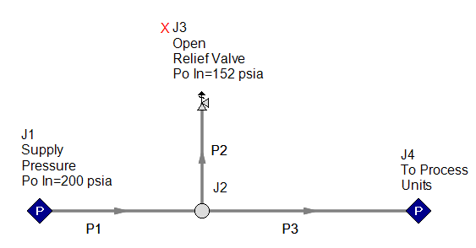
Example - Critical Pressure
Consider a relief valve being sized for a system
What is the critical pressure at the relief valve?
Restriction choking at relief valve
System has air with $γ≈1.39$ so ${P_{c}}/{P_{o,1}}=0.529$
Pc result follows 50% rule:
Pc ≈ 0.529 * 152 ≈ 81
Notes:
If the critical pressure were calculated using the supply pressure rather than the inlet pressure at the relief valve, Pc = 106 psia, 32% error
Note this model is included on the USB drive for students to reference if desired

Slide 29
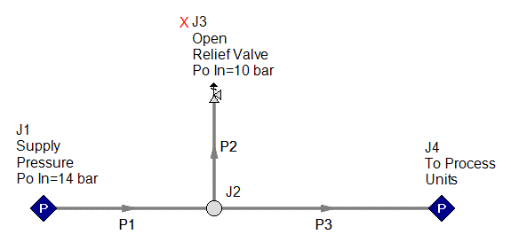
Example - Critical Pressure
Consider a relief valve being sized for a system
What is the critical pressure at the relief valve?
Restriction choking at relief valve
System has air with $γ≈1.39$ so ${P_{c}}/{P_{o,1}}=0.529$
Pc result follows 50% rule:
Pc ≈ 0.529 * 10.2 ≈ 5.4
Notes:
If the critical pressure were calculated using the supply pressure rather than the inlet pressure at the relief valve, Pc = 7.42 bar, about 38% error
Note this model is included on the USB drive for students to reference if desired

Slide 30
Review
Why is it important to accurately calculate the conditions downstream of a choke point?
D: All of the above
Safety requirements like those for maximum pipe surface temperature or noise levels must be adhered to throughout the system
Detrimental system conditions such as condensation could have serious impacts on operation
A: To determine if insulation is needed to protect against hot pipe surfaces
B: To avoid condensation downstream of the choke point
C: To calculate noise levels caused by high velocities
D: All of the above

Slide 31
Summary
Arrow can account for choking at restrictions, expansions and endpoints
A CdA (or Cv/Xt for valves) must be provided to account for restriction choking
Multiple choke points in one system can exist
When choking occurs Arrow must iterate to determine the choked flowrate in the system
Parameters downstream of restriction or expansion choke points are determined based on the downstream boundary condition
The mass flowrate in choked systems can only be affected by inlet conditions – decreasing the outlet pressure will not increase flow

