Slide 1
AFT Products & Industry Standards

Slide 2
AFT Products & Industry Standards
Industry Standards are a set of criteria within an industry relating to the standard functioning and carrying out of operations in their respective fields of production. In other words it is the generally accepted requirements followed by the members of an industry.
Many prospects and customers are not aware of these Standards and the importance for the security of the plant or pipeline to include them in their design.
It is important to create awareness of these standards and how AFT products can help the customers meet these requirements.

Slide 3
AFT Products & Industry Standards (2)
Not all countries use the same standards but most of the standards use similar criteria. It is up to the user to find these variances and figure out how AFT products can help the customers meet them.

Slide 4
API and HI: Pump Operating Range
POR
Preferred Operating Range
Tighter range
AOR
Allowable Operating Range
Looser range
Proximity of the pump operating point to the pump Best Efficiency Point (BEP) is important to:
Reduce pump vibration
Reduce energy consumption
Reduce maintenance costs

Slide 5
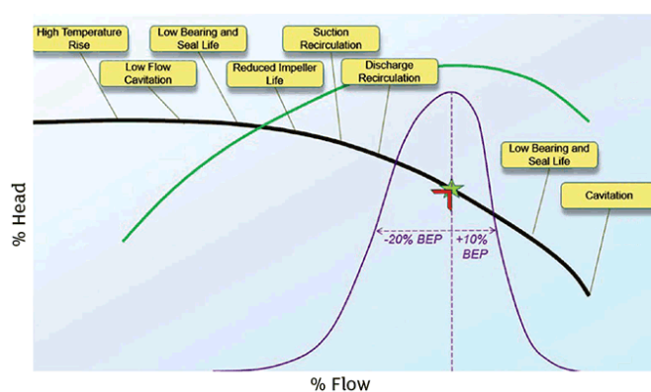
Avoid Oversizing Your Pump (5)

Slide 6
API and HI: Pump Operating Range (2)
AFT products will report how close the pump is operating to the BEP
These standards are recommended guidelines and not mandatory
API 610
Centrifugal Pumps for Petroleum, Petrochemical and Natural Gas Industries
ANSI/HI 9.6.3-2017
Guideline for Operating Regions

Slide 7
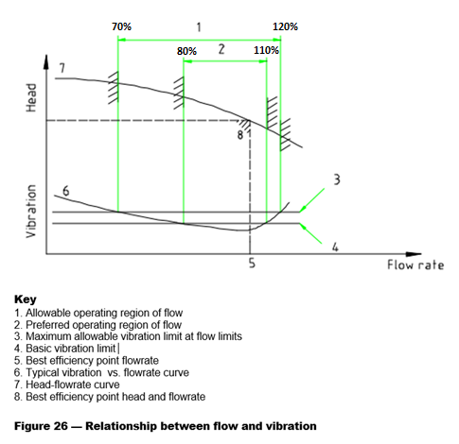
API and HI: Pump Operating Range (3)

Slide 8
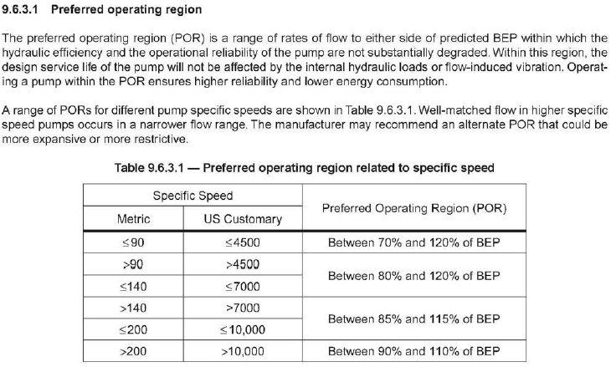
API and HI: Pump Operating Range (4)

Slide 9
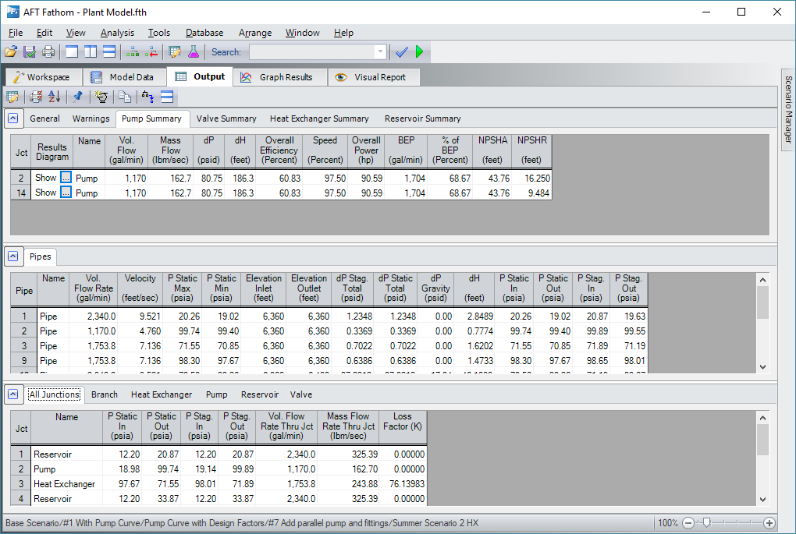
API and HI: Pump Operating Range (5)

Slide 10
NFPA: Fire Systems
Fire fighting systems
NFPA 13: Standard for the Installation of Sprinkler Systems
NFPA 15: Standard for Water Spray Fixed Systems for Fire protection
Both Standards require:
Determine the location of the remote nozzle
NFPA
“When it is not obvious by comparison that the design selected is the hydraulically most remote, additional calculations should be submitted. The most distant area is not necessarily the hydraulically most remote.”
Prepare a standard report using the remote nozzle hydraulic path

Slide 11
NFPA: Fire Systems (2)
AFT Fathom will help the customer:
Locate the remote nozzle using GSC
Prepare the NFPA Standard report

Slide 12
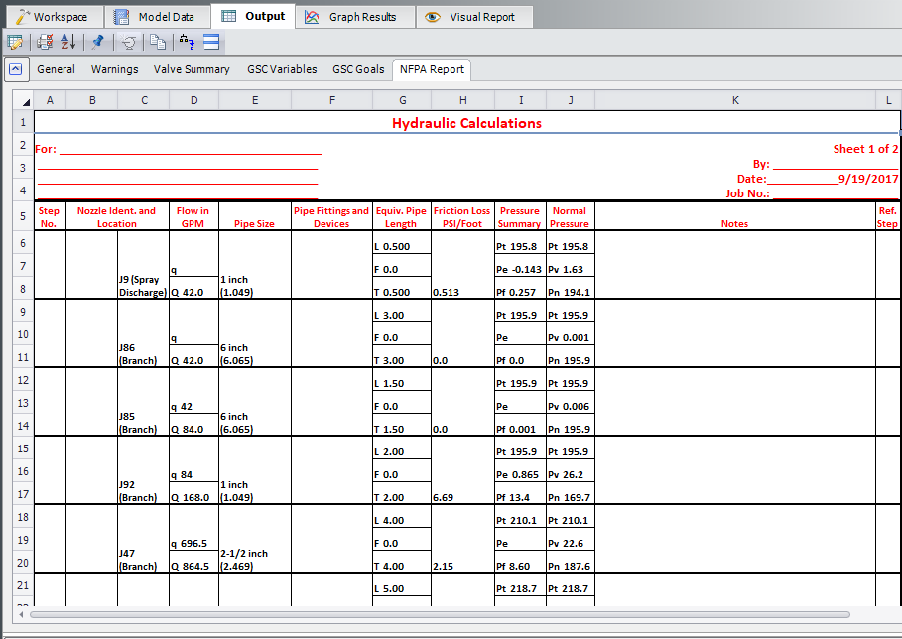
NFPA: Fire Systems (3)

Slide 13
ASME: Surge Analysis and Allowable Pressure
B31.4: Pipeline Transportation Systems for Liquid Hydrocarbons and Other Liquids

Slide 14
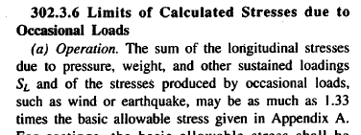
ASME: Surge Forces
B31.3: Process Piping
AFT Impulse can help meet this criteria by means of using a transient force calculation capability and exporting it to a pipe stress program

Slide 15
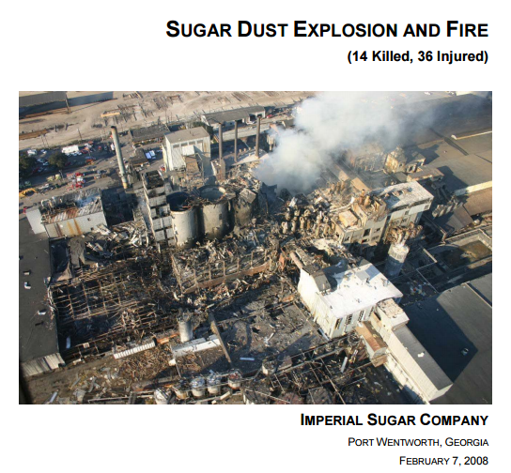
NFPA: Dust Collection
NFPA 654: Standard for the Prevention of Fire and Dust Explosions from the Manufactur­ing, Processing, and Handling of Combustible Particulate Solids

Slide 16
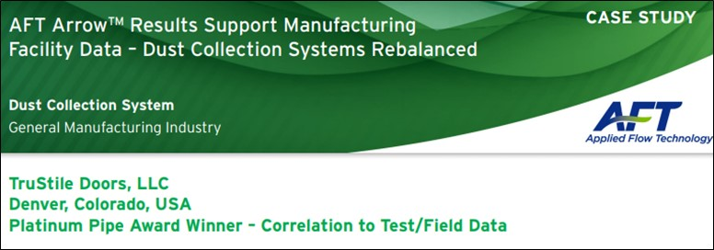
NFPA: Dust Collection (2)
Dust collection systems have a minimum velocity requirement to avoid dust accumulating to a concentration level where it can explode
AFT Arrow can help meet this criteria
Case study:

Slide 17
ASTM: Pipe or Insulation Surface Temperature
ASTM C1055: Standard Guide for Heated System Surface Conditions that Produce Contact Burn Injuries
AFT Fathom and Arrow calculate surface temperatures and can help meet this criteria

Slide 18
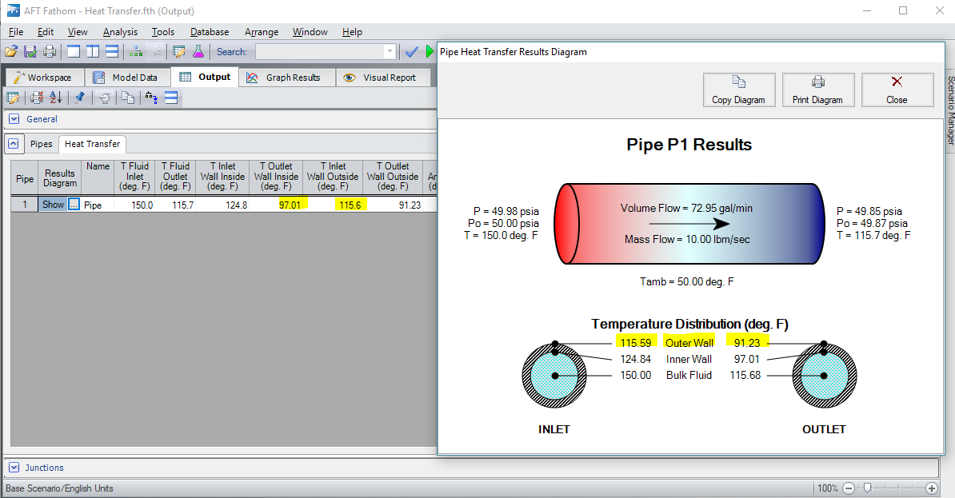
ASTM: Pipe or Insulation Surface Temperature (2)

Slide 19
API, ASME, ISO: Gas Relief Valve Piping
API RP520
Design and Installation of Pressure Relieving Systems in Refineries
Recommended practice
ASME Boiler and Pressure Vessel Code, Sec. VIII
Non-mandatory Appendix M
ISO 4126-9
Safety Devices for Protection Against Excessive Pressure
Mandatory

Slide 20
API, ASME, ISO: Gas Relief Valve Piping (2)
All three standard have different requirements for the inlet piping to the relief valve and the discharge piping
They also can vary depending on the operating conditions, the gas involved and the type of relief valve used
A common requirement for the inlet piping is that the pressure drop is < 3% of the relief valve set pressure
A common requirement for the discharge piping is that the pressure drop is < 10% of the relief valve set pressure
AFT Arrow can help with these calculations and meet these standards guidelines/requirements

Slide 21
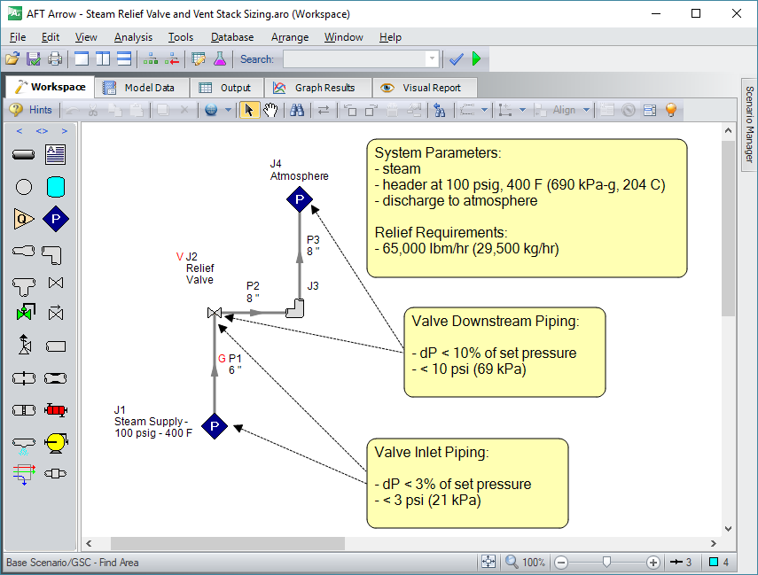
API and ASME: Gas Relief Valve Piping (3)

Slide 22
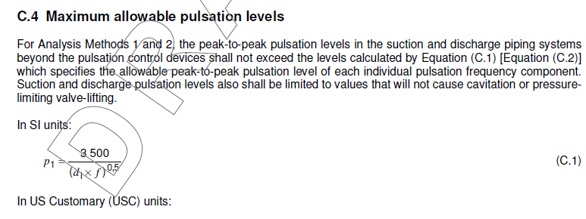
API: Allowable Pump Pulsation
API 674: Petroleum, petrochemical and natural gas industries — Reciprocating positive displacement pumps
Peak-to-peak pulsation limits

Slide 23
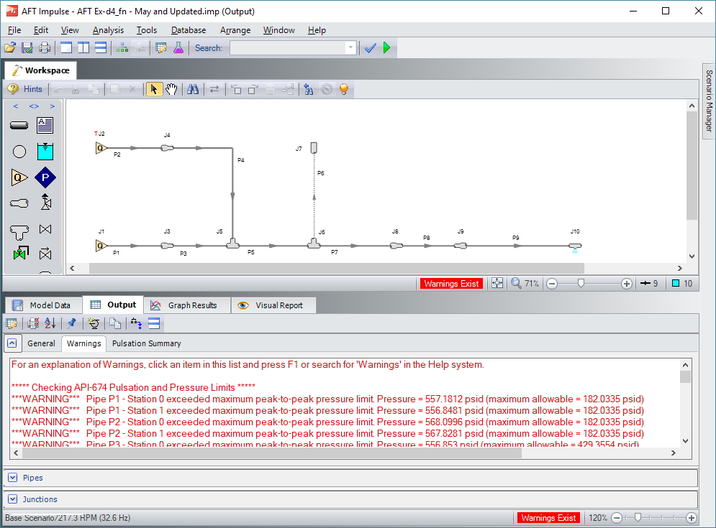
API: Allowable Pump Pulsation (2)
AFT Impulse PFA module calculates compliance

Slide 24
API: Allowable Pump Pulsation (3)

Slide 25
API: Allowable Compressor Pulsation
API 618: Reciprocating Compressors for Petroleum, Chemical, and Gas Industry Services
Peak-to-peak pulsation limits
Coming in 2018 in AFT XStream PFA module

Slide 26
HI: Pump Viscosity Corrections
ANSI/HI 9.6.7
Effects of Liquid Viscosity on Rotodynamic (Centrifugal and Vertical) Pump Performance
AFT Fathom and AFT Impulse have these corrections available
Important many types of applications including crude oil pumps

Slide 27
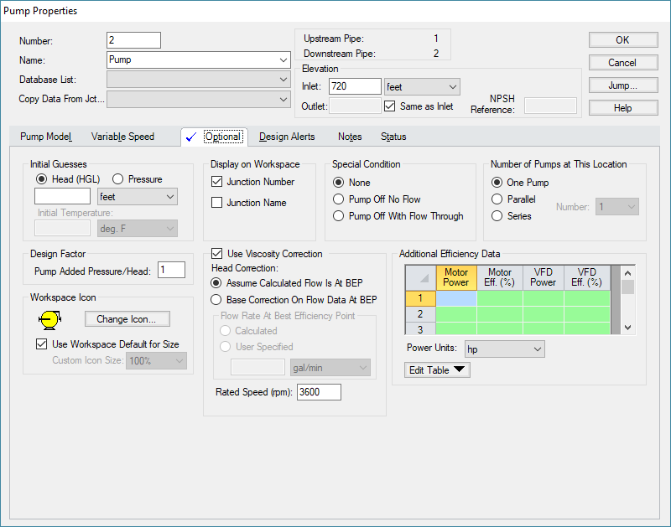
HI: Pump Viscosity Corrections (2)

Slide 28
HI: Pump Viscosity Corrections (2)
Pump correction factors from standard

Slide 29
HI: Slurry Pump Corrections
ANSI/HI 12.1-12.6
Rotodynamic (Centrifugal) Slurry Pumps
Slurry pumps convey the pumping of solid particles
This degrades the pump performance
This is commonly called “pump de-rating”

Slide 30
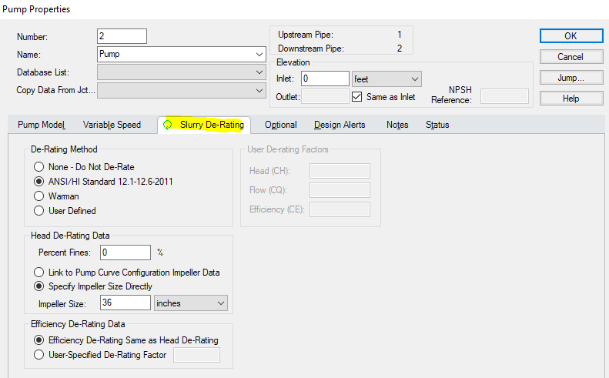
HI: Slurry Pump Corrections (2)

Slide 31
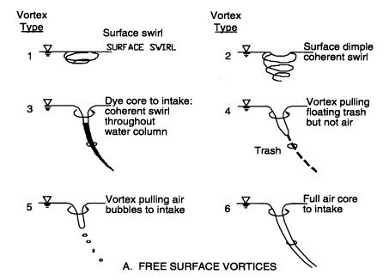
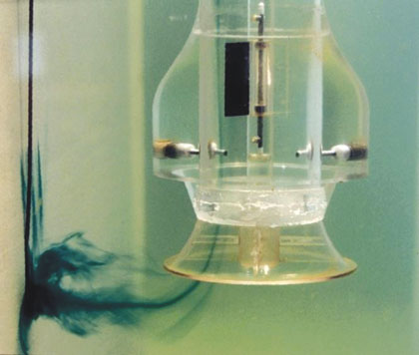
HI: Pump Submergence
ANSI/HI 9.8:
Rotodynamic Pumps for Pump Intake Design
Submergence relates to having adequate supply liquid depth to avoid vortices from forming and reaching the pump

Slide 32
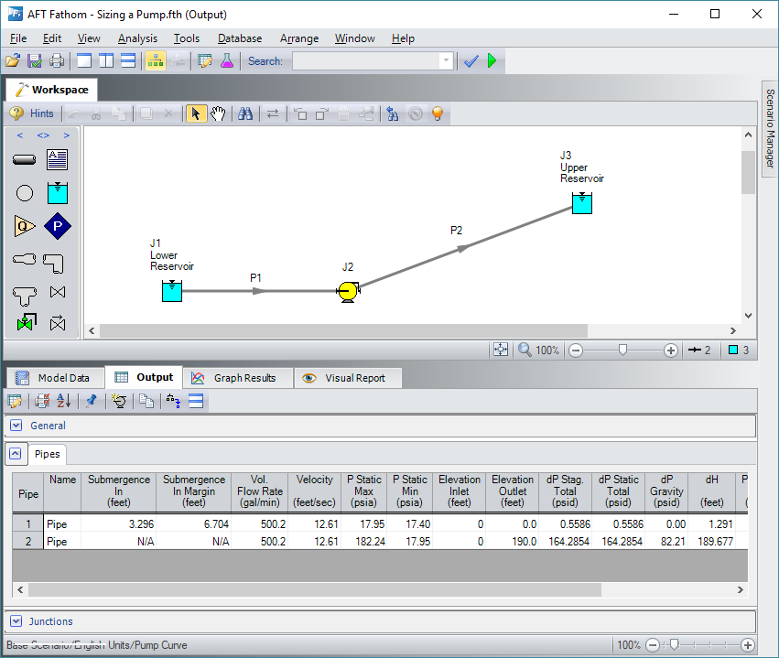
HI: Pump Submergence (2)
AFT Fathom calculates pump submergence and the margin from the standard allowable

Slide 33
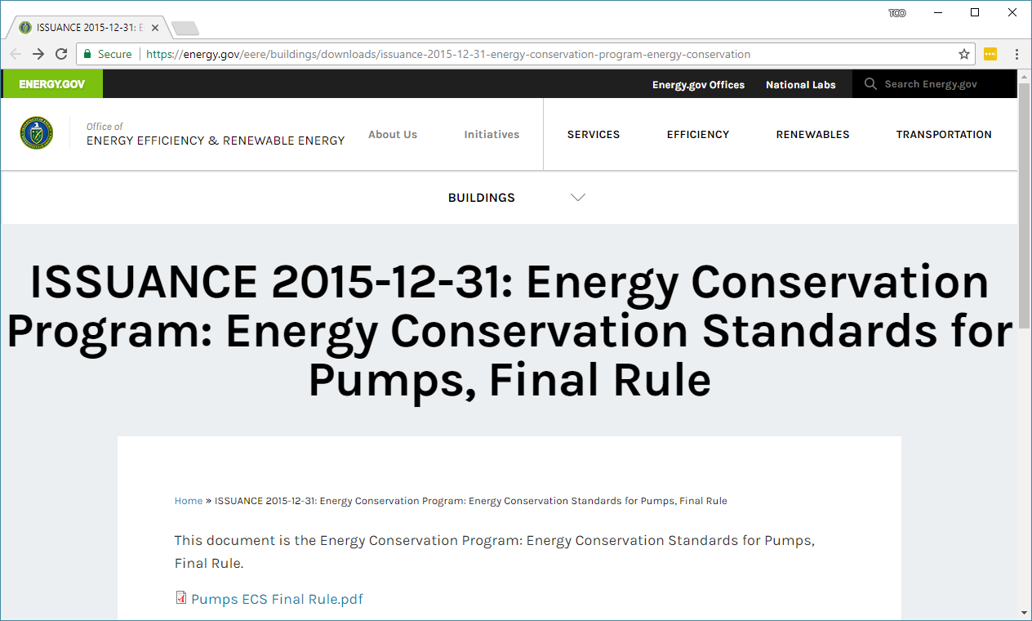
U.S. DOE: Efficiency Standards for Pumps

Slide 34
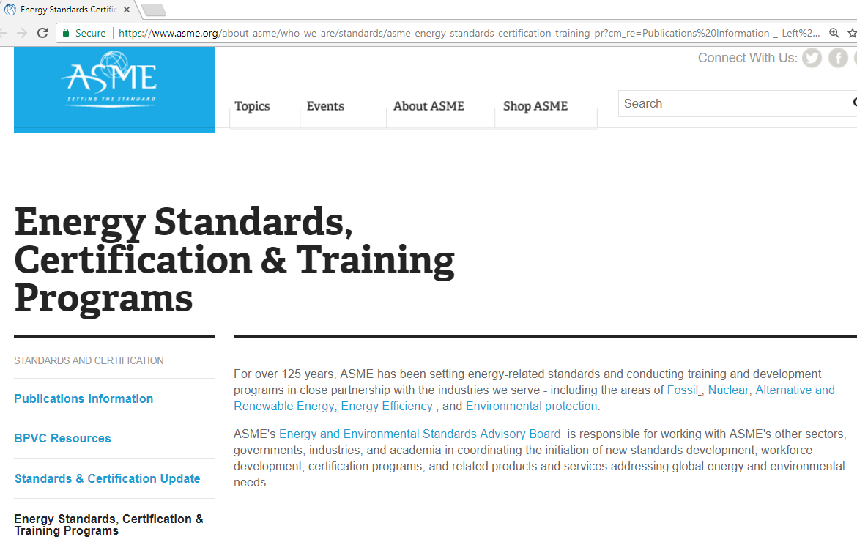
ASME Energy Standards Evolving

Slide 35
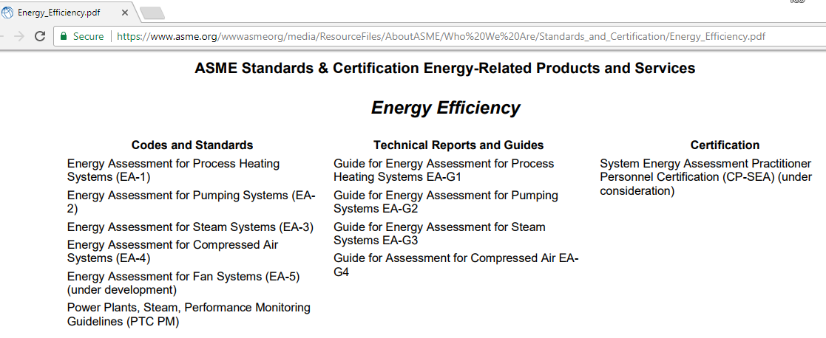
ASME Standards Related to AFT Software

Slide 36
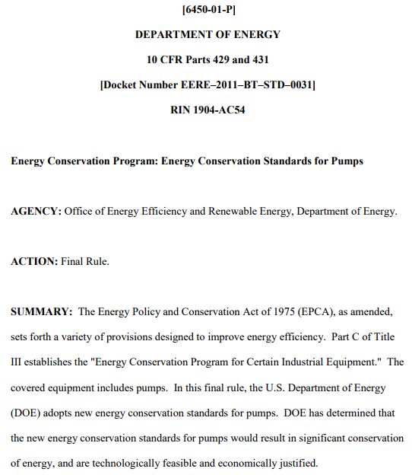
Efficiency Standards for Pumps (2)

Slide 37
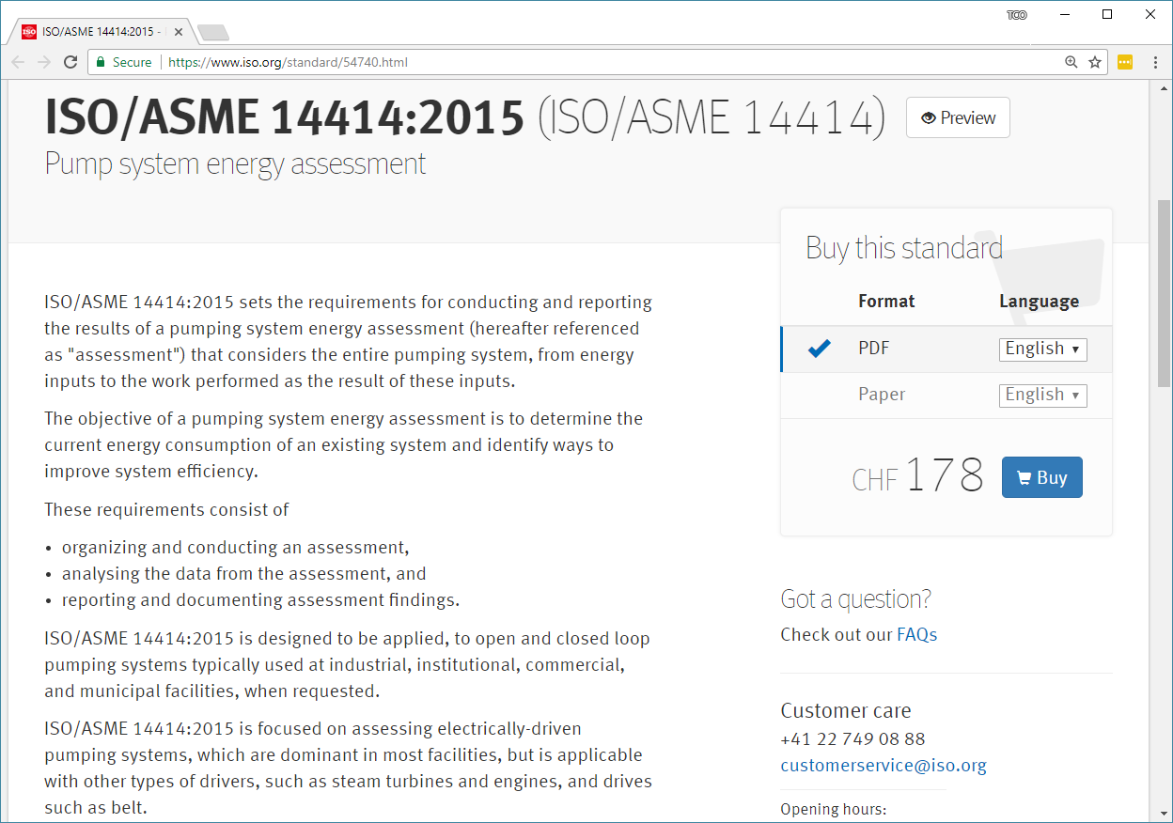
ISO Pump Energy Standards from ASME

Slide 38
Summary of Standards
API Pump Pulsation Pressures
API Compressor Pulsation Pressures
ANSI/HI Pump Viscosity Corrections
ANSI/HI Slurry Pump De-Rating
ANSI/HI Pump Submergence
ASME/ISO Energy Standards
API and HI Pump Preferred Operating Range
NFPA Fire System Calculations
ASME Surge Analysis and Allowable Pressure
ASME Surge Forces
NFPA Dust Collection
ASTM Surface Temperature Allowables
ASME, API and ISO Gas Relief System Piping

